Slide 1
AI 620 EMERGING TOPICS IN ARTIFICIAL INTELLIGENCE
Module 10
Model Accuracy Degradation and Feedback Loops

Slide 2
Learning outcomes
Monitoring models for degraded performance
Developing a use case for evolving training data --- ad-click conversion
Creating a machine learning feedback loop

Slide 3
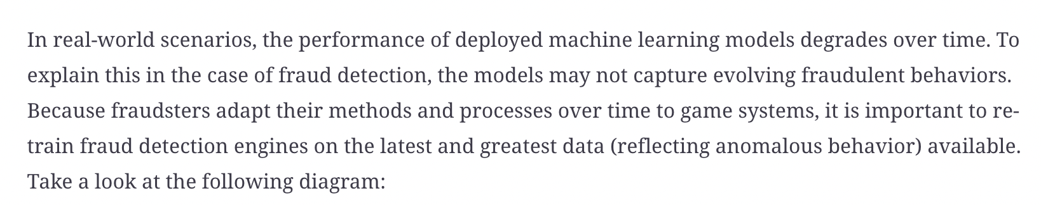
Monitoring models for degraded performance

Slide 4
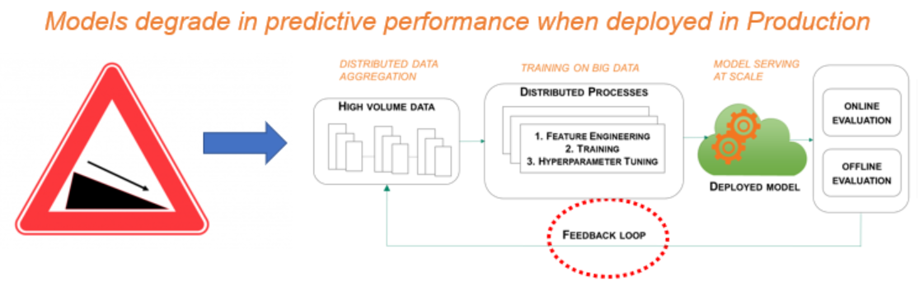
Diagram

Slide 5
Developing a use case for evolving training data – ad-click conversion
Fraud risk is prevalent in almost every industry, for example, airlines, retail, financial services, and so on. The risk is especially high in online advertising. For companies investing in digital marketing, it is important to contain costs from fraudulent clicks on ads. Online advertising can become cost-prohibitive if fraudulent behavior is rampant across online ad channels. In this chapter, we will look at ad-click data for mobile apps and predict which clicks will likely yield app downloads. The outcome of this prediction exercise will allow mobile app developers to efficiently allocate online marketing dollars.

Slide 6
Ad-click conversion
Ad-click behavior is very dynamic. This behavior changes across time, location, and ad channels. A fraudster can develop software to automate clicking on mobile app ads and conceal the identity of clicks—clicks can be generated from multiple IP addresses, devices, operating systems, and channels. To catch this dynamic behavior, it is important to retrain classification models to cover new and emerging patterns. Implementing a feedback loop becomes critical if we wish to accurately determine which clicks will result in app downloads.

Slide 7
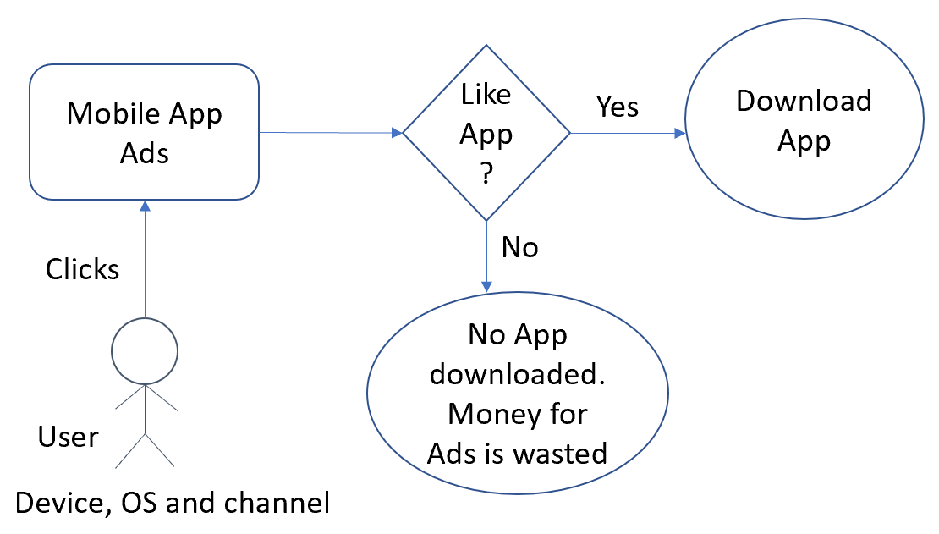
Ad-click behavior

Slide 8
Creating a machine learning feedback loop
In this section, we will demonstrate how retraining a classification model as new data becomes available will enhance model performance; that is, it will predict which ad-clicks will result in mobile app downloads.

Slide 9
Data
ip: the IP address of the click
app: The type of mobile app
device: The type of device the click is coming from (for example, iPhone 6 plus, iPhone 7)
os: The type of operating system the click is coming from
channel: The type of channel the click is coming from
click_time: The timestamp of the click (UTC)
is_downloaded: The target that is to be predicted, indicating the app was downloaded

Slide 10
A tree-based model
To understand the significance of a feedback loop, we will train a tree-based model (XGBoost) to predict the probability of an ad-click (related to an app) that results in the app being download. We will run three different experiments.

Slide 11
Experiments
Experiment 1: Train on the click data for Monday and predict/score a portion of the clicks from Thursday (clicks from a later part of the day).
Experiment 2: Let's assume that we have more data available in the data lake environment to retrain the classification model. We will train on the click data for Monday, Tuesday, and Wednesday and predict/score a portion of the clicks from Thursday.
Experiment 3: Similarly, we will train on click data for Monday, Tuesday, Wednesday and part of Thursday and predict/score a portion of the clicks from Thursday.

Slide 12
Evaluation
The classification model's performance measured by area under curve (AUC) increases. AUC is measured by plotting the true positive rate against the false positive rate.
That a random classifier has an AUC of 0.5.
For an optimal model, the AUC should be closer to 1.
In other words, the true positive rate (the proportion of the app downloads that you've correctly identified) should be higher than the false positive rate (the proportion of clicks that did not result in any app downloads but has been identified as yielding app downloads).

Slide 13
Predict Ad Click Conversion through XGBoost
PE10-1 Exploring data
Go through steps 1-4 from textbook page 377 to understand about the data
PE10-2 Creating features
Go through steps 1-6 from textbook page 381
PE10-3 Amazon SageMaker XGBoost
Go through steps 1-9 from textbook page 384
PE10-4 Evaluating model performance
Go through steps 1-6 from textbook page 387
DONE!!!

Slide 14
ABOUT 10-3 Step7 Hyper parameters
max_depth: The maximum number of levels between the tree's root and a leaf.
eta: Learning rate.
gamma: The node is only split when the resulting split gives a positive reduction in the loss function. Gamma specifies the minimum loss reduction required to make a split.
min_child_weight: This is used to control tree complexity and the minimum sum of instance weight needed in a child. If this threshold is not met, then tree partitioning will stop.
subsample: The fraction of observations to be randomly sampled for each tree.
colsample_bytree: The fraction of columns to be randomly sampled for each tree.
scale_pos_weight: The dataset is highly imbalanced, where we have a large number of clicks (> 90%) that did not result in app downloads. To account for this, the scale_pos_weight hyperparameter is used to give clicks that resulted in app downloads more weight. These clicks are heavily underrepresented in the dataset.
alpha: A regularization parameter to prevent overfitting. Alpha is used to implement L1 regularization, where the sum of the weights of leaves is part of the regularization term (of the objective function).
lambda: This is used to control L2 regularization, where the sum of the squares of weights is part of the regularization term.

Slide 15
Optimization
While most of the default values for the hyperparameters are accepted, some are explicitly defined here. For instance, min_child_weight is set to 6, while the default value is 1. This means that a leaf node should have a sizeable number of instances or data points before it can be split further. These values can be tuned for the data in question. Hyperparameter optimization (HPO), from SageMaker, can be used to automate the process of finding optimal values for hyperparameters.

Slide 16
References
Tripuraneni, S., & Song, C. (2019). Hands-On Artificial Intelligence on Amazon Web Services. Packt Publishing. https://learning.oreilly.com/library/view/hands-on-artificial-intelligence/9781789534146/

